Slide 1
Chapter 2
Discrete-Time
Signals and Systems

Slide 2
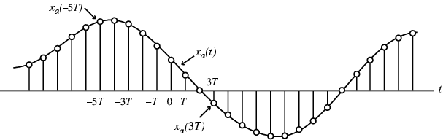
§2.1 Discrete-Time Signals:
Time-Domain Representation
Signals represented as sequences of numbers, called samples
In some applications, a discrete-time sequence {x[n]} may be generated by periodically sampling a continuous-time signal x_{a}(t) at uniform intervals of time

Slide 3
§2.1 Discrete-Time Signals:
Time-Domain Representation
Here, n-th sample is given by
x[n]=x_{a}(t) |_{t=nT}=x_{a}(nT), n=…,-2,-1,0,1,…
The spacing T between two consecutive samples is called the sampling interval or sampling period
Reciprocal of sampling interval T, denoted as F_{T} , is called the sampling frequency:
F_{T}=1/T

Slide 4
§2.1 Discrete-Time Signals:
Time-Domain Representation
Two types of discrete-time signals:
- Sampled-data signals in which samples are continuous-valued
- Digital signals in which samples are discrete-valued
Signals in a practical digital signal processing system are digital signals obtained by quantizing the sample values either by rounding or truncation

Slide 5
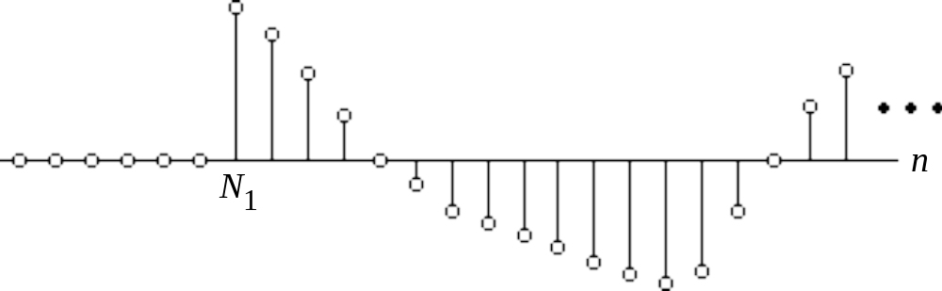
§2.1 Discrete-Time Signals:
Time-Domain Representation
A right-sided sequence x[n] has zero-valued samples for n < N₁
A right-sided sequence
If N₁≥ 0, a right-sided sequence is called a causal sequence

Slide 6
§2.2 Operations on Sequences
A single-input, single-output discrete-time system operates on a sequence, called the input sequence, according some prescribed rules and develops another sequence, called the output sequence, with more desirable properties
x[n]
Discrete-time
y[n]
system
Input sequence
Output sequence

Slide 7


§2.2.1 Basic Operations
Product (modulation) operation:
Modulator
x[n]
y[n]
y[n]=x[n].w[n]
w[n]
Addition operation:
  Adder
x[n]
y[n]
y[n]=x[n]+w[n]
w[n]
Multiplication operation
A
x[n]
y[n]
y[n]=A.x[n]
  Multiplier

Slide 8


§2.2.1 Basic Operations
Time-shifting operation, where N is an integer
If N > 0, it is delaying operation
  Unit delay
  y[n]=x[n-1]
x[n]
y[n]
If N < 0, it is an advance operation
-Unit advance
y[n]=x[n+1]
x[n]
y[n]

Slide 9
§2.2.1 Basic Operations
Time-reversal (folding) operation:
y[n]=x[-n]
Branching operation: Used to provide multiple copies of a sequence
x[n]
x[n]
x[n]

Slide 10
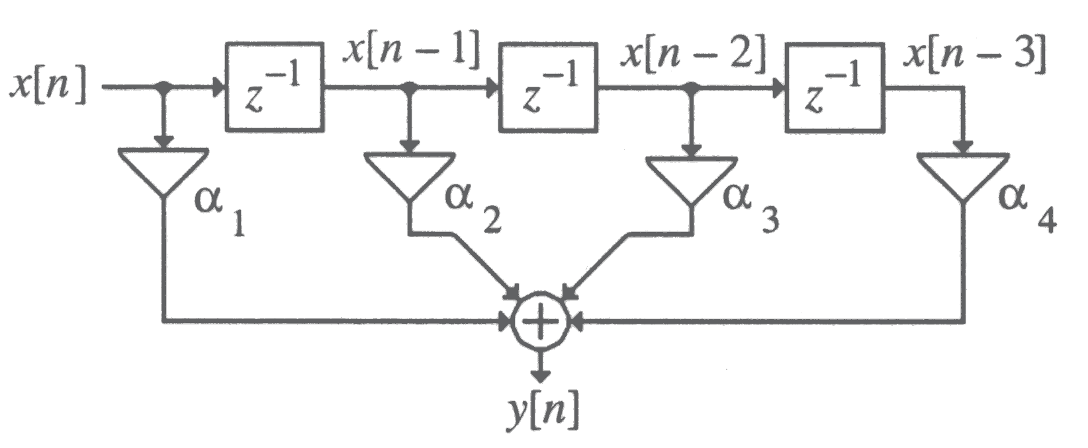
§2.2.1 Basic Operations
Example -
y[n]=α₁x[n]+ α₂x[n-1]+ α₃[n-2]+ α₄x[n-3]

Slide 11
§2.2.2 Sampling Rate Alteration
Employed to generate a new sequence y[n] with a sampling rate F’_{T} higher or lower than that of the sampling rate F_{T} of a given sequence x[n]
Sampling rate alteration ratio is
R= F’_{T} / F_{T}
If R > 1, the process called interpolation
If R < 1, the process called decimation

Slide 12
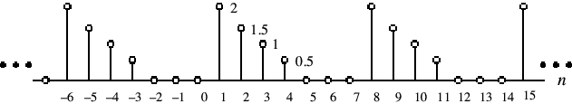
§2.2.3 Classification of Sequences based on periodicity
Example -
A sequence satisfying the periodicity condition is called an periodic sequence

Slide 13
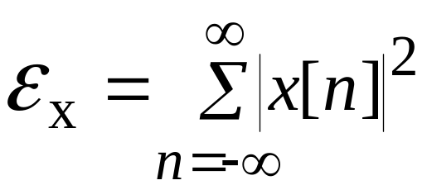
§2.2.4 Classification of Sequences Energy and Power Signals
Total energy of a sequence x[n] is defined by
An infinite length sequence with finite sample values may or may not have finite energy
A finite length sequence with finite sample values has finite energy

Slide 14
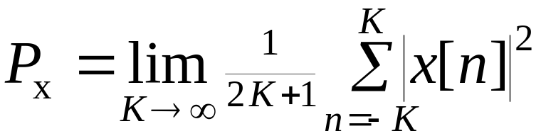
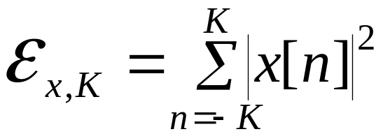
§2.2.4 Classification of Sequences Energy and Power Signals
The average power of an aperiodic sequence is defined by
Define the energy of a sequence x[n] over a finite interval -K≤ n ≤ K as

Slide 15
§2.2.4 Classification of Sequences Energy and Power Signals
An infinite energy signal with finite average power is called a power signal
Example - A periodic sequence which has a finite average power but infinite energy
A finite energy signal with zero average power is called an energy signal
Example - A finite-length sequence which has finite energy but zero average power

Slide 16
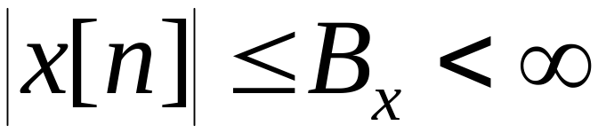
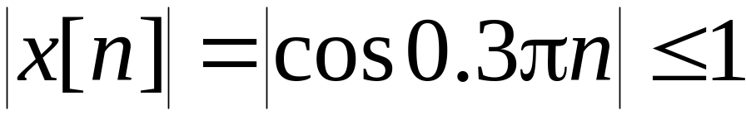
§2.2.4 Classification of Sequences bounded, absolutely summable and squaresummable
A sequence x[n] is said to be bounded if
Example - The sequence x[n]=cos(0.3πn) is a bounded sequence as

Slide 17
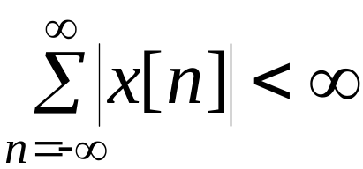
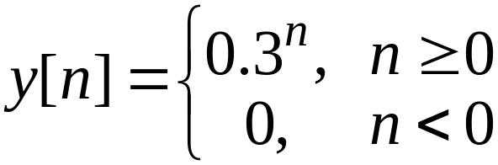
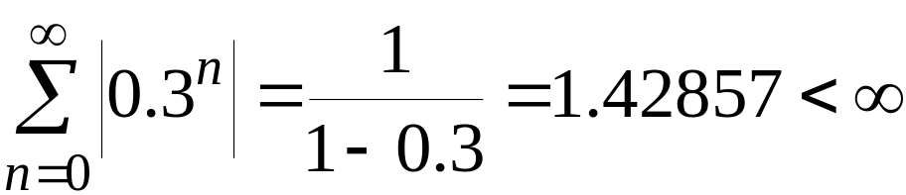
§2.2.4 Classification of Sequences bounded, absolutely summable and squaresummable
A sequence x[n] is said to be absolutely summable if
Example - The sequence
is an absolutely summable sequence as

Slide 18
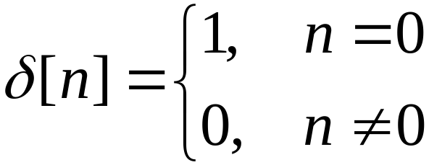
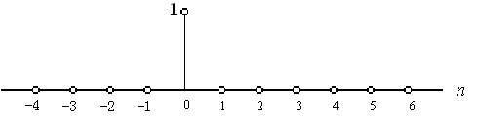
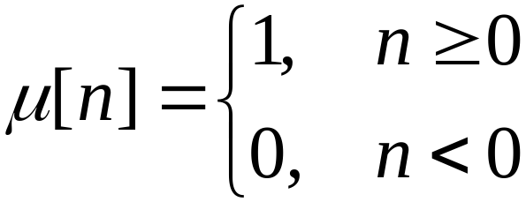
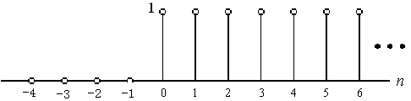
§2.3 Basic Sequences
Unit sample sequence -
Unit step sequence -

Slide 19
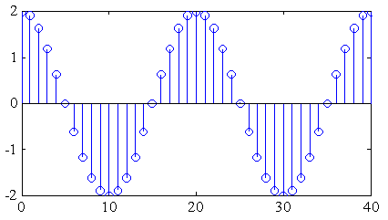
§2.3 Basic Sequences
Real sinusoidal sequence -
x[n]=Acos(ω₀n+ϕ)
where A is the amplitude, ω₀ is the angular frequency, and ϕ is the phase of x[n]
Example -

Slide 20
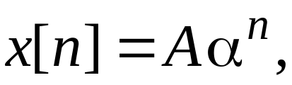

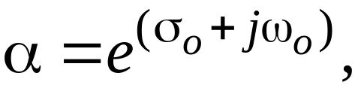
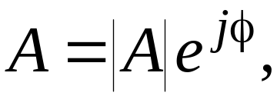
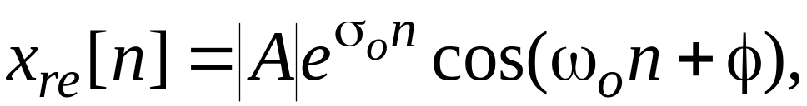
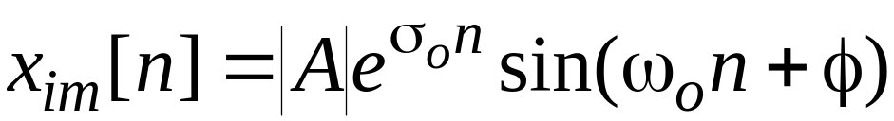
§2.3 Basic Sequences
Exponential sequence -
where A and α are real or complex numbers
If we write
then we can express
where

Slide 21
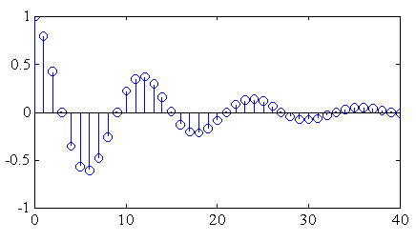
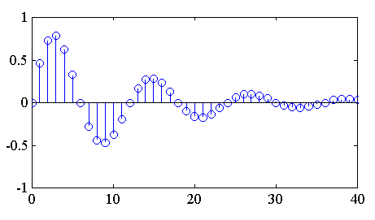
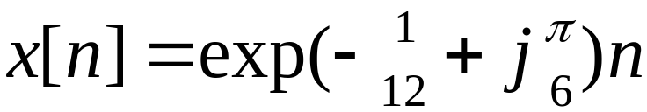
§2.3 Basic Sequences
x_{re}[n] and x_{im}[n] of a complex exponential sequence are real sinusoidal sequences with constant (σ₀=0), growing (σ₀>0) , and decaying (σ₀<0) amplitudes for n > 0
Real part
Imaginary part

Slide 22
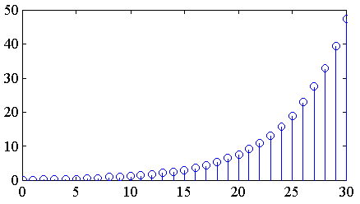
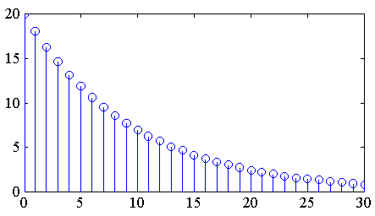
§2.3 Basic Sequences
Real exponential sequence -
x[n]=Aα^{n}, -∞< n < ∞
where A and α are real numbers
α=1.2
α=0.9

Slide 23
§2.3 Basic Sequences
Sinusoidal sequence Acos(ω₀n + ϕ) and complex exponential sequence Be^{jω}0^{n} are periodic sequences of period N if ω₀N=2πr
where N and r are positive integers
Smallest value of N satisfying ω₀N=2πr
is the fundamental period of the sequence
To verify the above fact, consider
x₁[n]= Acos(ω₀n + ϕ)
x₂[n]= Acos(ω₀ ( n+N) + ϕ)

Slide 24
§2.3 Basic Sequences
Now
x₂[n]= cos(ω₀ ( n+N) + ϕ)
= cos(ω₀n+ϕ)cosω₀N - sin(ω₀n+ϕ)sinω₀N
which will be equal to cos(ω₀n+ϕ)=x₁[n] only if sinω₀N= 0 and cosω₀N = 1
These two conditions are met if and only if ω₀N= 2πr or 2π/ω₀ = N/r

Slide 25
§2.3 Basic Sequences
If 2π/ω₀ is a noninteger rational number, then the period will be a multiple of 2π/ω₀
Otherwise, the sequence is aperiodic
Example - x[n]=sin(√3n+ϕ) is an aperiodic sequence

Slide 26
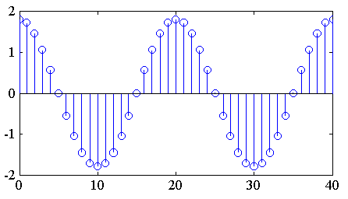
§2.3 Basic Sequences
ω₀ = 0.1π
Here ω₀ = 0.1π
Hence N= 2πr/ω₀ = 20 for r = 1

Slide 27
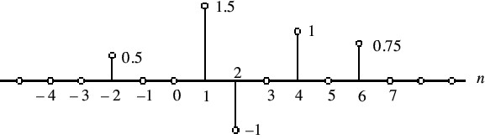

§2.3 Basic Sequences
An arbitrary sequence can be represented in the time-domain as a weighted sum of some basic sequence and its delayed (advanced) versions

Slide 28
§2.4 The Sampling Process
Often, a discrete-time sequence x[n] is developed by uniformly sampling a continuous-time signal x_{a}(t) as indicated below
The relation between the two signals is
x[n]=x_{a}(t)|_{t=nT}=x_{a}(nT), n=…, -2, -1, 0, 1, 2, …

Slide 29
§2.4 The Sampling Process
Time variable t of x_{a}(t) is related to the time variable n of x[n] only at discrete-time instants t_{n} given by
t_{n}= nT = n/F_{T} = 2πn/ Ω_{T}
with F_{T}=1/T denoting the sampling frequency and Ω_{T}= 2πF_{T} denoting the sampling angular frequency

Slide 30
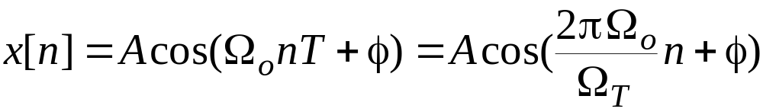


§2.4 The Sampling Process
Consider the continuous-time signal
The corresponding discrete-time signal is
where
is the normalized digital angular frequency of x[n]

Slide 31
§2.4 The Sampling Process
If the unit of sampling period T is in seconds
The unit of normalized digital angular frequency ω₀ is radians/sample
The unit of analog frequency f₀ is hertz (Hz) (cycles/second)
The unit of analog angular frequency Ω₀ is radians/second
The unit of sampling frequency f_{T} is samples/second
So, the unit of normalized digital angular frequency ω₀ is radians/sample

Slide 32
§2.4 The Sampling Process
Recall
ω₀=2πΩ₀/Ω_{T}
Thus if Ω_{T}>2Ω₀ , then the corresponding normalized digital angular frequency ω₀ of the discrete-time signal obtained by sampling the parent continuous-time sinusoidal signal will be in the range -π<ω<π
Conclusion: No aliasing

Slide 33
§2.4 The Sampling Process
On the other hand, if Ω_{T} < 2Ω₀ , the normalized digital angular frequency will foldover into a lower digital frequency
ω₀ = ( 2 π Ω₀ / Ω_{T})_{2π} in the range -π<ω<π because of aliasing
Hence, to prevent aliasing, the sampling frequency Ω_{T} should be greater than 2 times the frequency Ω₀ of the sinusoidal signal being sampled

Slide 34
§2.4 The Sampling Process
Generalization: Consider an arbitrary continuous-time signal x_{a}(t) composed of a weighted sum of a number of sinusoidal signals
x_{a}(t) can be represented uniquely by its sampled version {x[n]} if the sampling frequency Ω_{T} is chosen to be greater than 2 times the highest frequency contained in x_{a}(t)
The condition to be satisfied by the sampling frequency to prevent aliasing is called the sampling theorem (Nyquest theorem)

Slide 35
§2.5 Discrete-Time Systems
A discrete-time system processes a given input sequence x[n] to generates an output sequence y[n] with more desirable properties
In most applications, the discrete-time system is a single-input, single-output system:
x[n]
Discrete-Time
System
y[n]
Input sequence
Output sequence

Slide 36
§2.5 Discrete-Time Systems
Linear System
Shift-Invariant System
Causal System
Stable System
Passive and Lossless Systems

Slide 37
§2.5.1 Linear Discrete-Time Systems
Definition - If y₁[n] is the output due to an input x₁[n] and y₂[n] is the output due to an input x₂[n] then for an input
x[n]=ax₁[n]+bx₂[n]
the output is given by
y[n]=ay₁[n]+by₂[n]
Above property must hold for any arbitrary constants a and b and for all possible inputs x₁[n] and x₂[n]
Hence, the above system is linear

Slide 38
§2.5.1 Shift-Invariant System
For a shift-invariant system, if y₁[n] is the response to an input x₁[n] , then the response to an input
x[n]=x₁[n-n₀]
is simply
y[n]=y₁[n-n₀]
where n₀ is any positive or negative integer
The above relation must hold for any arbitrary input and its corresponding output
The above property is called time-invariant property, or shift-invariant property

Slide 39
§2.5.2 Linear Time-Invariant system
Linear Time-Invariant (LTI) System -
A system satisfying both the linearity and the time-invariant property
LTI systems are mathematically easy to analyze and characterize, and consequently, easy to design
Highly useful signal processing algorithms have been developed utilizing this class of systems over the last several decades

Slide 40
§2.5.4 Impulse and Step Responses
The response of a discrete-time system to a unit sample sequence δ[n] is called the unit impulse response or simply, the impulse response, and is denoted by h[n]
The response of a discrete-time system to a unit step sequence μ[n] is called the unit step response or simply, the step response, and is denoted by s[n]

Slide 41
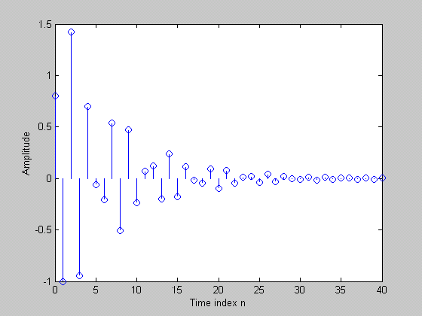
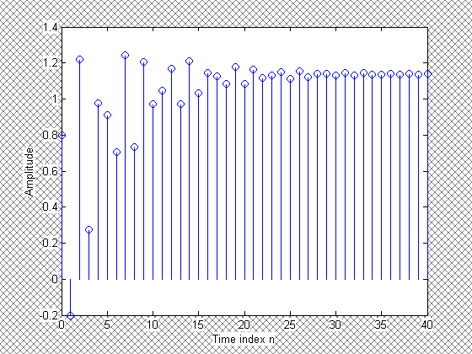
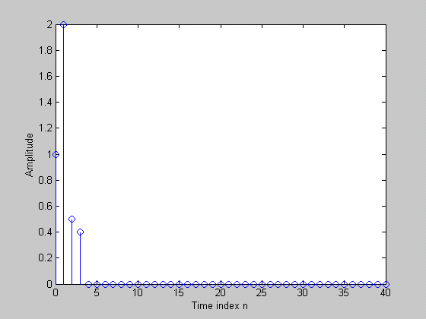
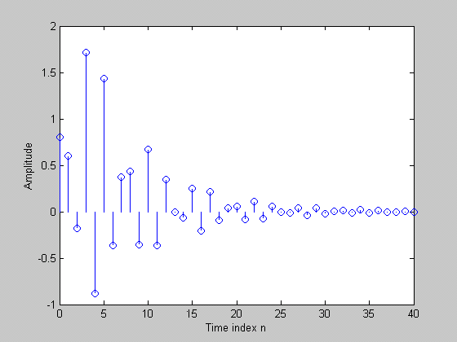
Impulse and step response
By changing the input signal ,we get another response of the same system.
Input signal
response

Slide 42
§2.6 Time-Domain Characterization of LTI Discrete-Time System
Input-Output Relationship - A consequence of the linear, time-invariance property is that an LTI discrete-time system is completely characterized by its impulse response
Knowing the impulse response one can compute the output of the system for any arbitrary input

Slide 43
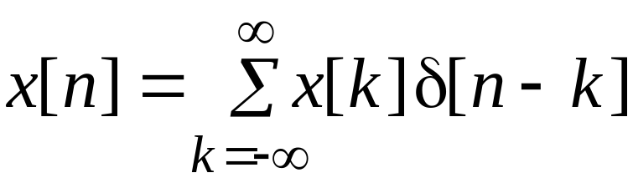
§2.6 Time-Domain Characterization of LTI Discrete-Time System
Now, any arbitrary input sequence x[n] can be expressed as a linear combination of delayed and advanced unit sample sequences in the form
The response of the LTI system to an input x[k]δ[n-k] will be x[k]h[n-k]

Slide 44
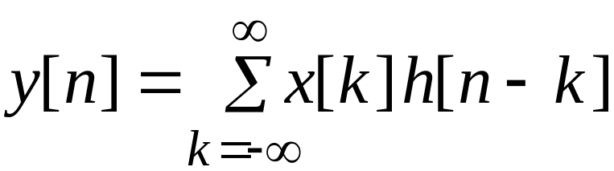
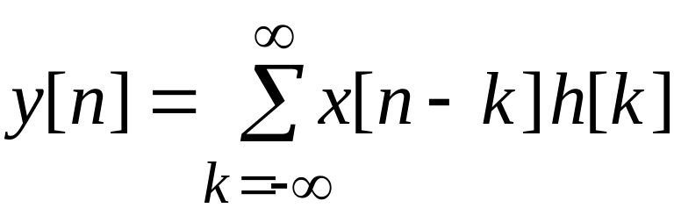
§2.6 Time-Domain Characterization of LTI Discrete-Time System
Hence, the response y[n] to an input
will be
which can be alternately written as

Slide 45
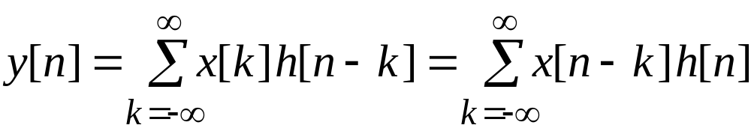
§2.6.1 Convolution Sum
The summation
is called the convolution sum of the sequences x[n] and h[n] and represented compactly as
y[n] = x[n] h[n]
*

Slide 46
§2.6.1 Convolution Sum
Properties -
Commutative property:
x[n] h[n] = h[n] x[n]
*
*
Associative property :
(x[n] h[n]) y[n] = x[n] (h[n] y[n])
*
*
*
*
Distributive property :
x[n] (h[n] + y[n]) = x[n] h[n] + x[n] y[n]
*
*
*

Slide 47
§2.6.1 Convolution Sum
Interpretation -
1) Time-reverse h[k] to form h[-k]
2) Shift h[-k] to the right by n sampling periods if n > 0 or shift to the left by n sampling periods if n < 0 to form h[n-k]
3) Form the product v[k]=x[k]h[n-k]
4) Sum all samples of v[k] to develop the n-th sample of y[n] of the convolution sum

Slide 48
x[n] = h[n] = δ[n] + δ[n-1] + δ[n-2]
x[k]
x[k]
x[k]
x[k]
x[k]
x[k]
h[k]
h[-k]
h[1-k]
h[2-k]
h[3-k]
h[4-k]
y[0]
y[1]
y[2]
y[3]
y[4 ]
y[n]=δ[n]+2δ[n-1]+3δ[n-2]+2δ[n-3]+δ[n-4]

Slide 49
§2.6.1 Convolution Sum
In general, if the lengths of the two sequences being convolved are M and N, then the sequence generated by the convolution is of length M+N-1

Slide 50
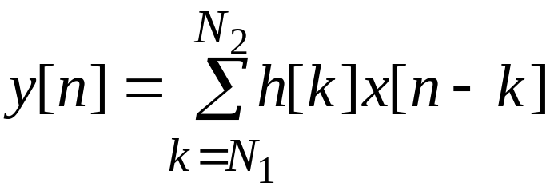
§2.7 Classification of LTI Discrete-Time Systems
Based on Impulse Response Length -
If the impulse response h[n] is of finite length, i.e.,
h[n]=0 for n<N₁, N₂<n and N₁<N₂
then it is known as a Finite Impulse Response (FIR) discrete-time system
The convolution sum description here is

Slide 51
§2.7 Classification of LTI Discrete-Time Systems
The output y[n] of an FIR LTI discrete-time system can be computed directly from the convolution sum as it is a finite sum of products
Examples of FIR LTI discrete-time systems are the moving-average system and the linear interpolators

Slide 52
§2.7 Classification of LTI Discrete-Time Systems
If the impulse response is of infinite length, then it is known as an Infinite Impulse Response (IIR) discrete-time system
The class of IIR systems we are concerned with in this course are characterized by linear constant coefficient difference equations

Slide 53
§2.7 Classification of LTI Discrete-Time Systems
Example - The discrete-time accumulator defined by
y[n]=y[n-1]+x[n]
is seen to be an IIR system

Slide 54
§2.7 Classification of LTI Discrete-Time Systems
Based on the Output Calculation Process
Nonrecursive System - Here the output can be calculated sequentially, knowing only the present and past input samples
Recursive System - Here the output computation involves past output samples in addition to the present and past input samples

Slide 55
Homework
Problems
2.2, 2.5, 2.23, 2.28, 2.57, 2.58

